Slide 1
Spring Boot
Bootstrap your application development, batteries included!

Slide 2
Spring Boot
Spring Boot is the easiest way to launch a new application and maintain an existing one.
“Starter” dependencies include all required dependencies for standard applications
Curated compatibility of all dependency versions
Auto configures deployment environment
Easily override defaults
Easily snap in to EOS and/or Propstore

Slide 3
Spring Boot minimum requirements
Java 8 or greater
Maven 3 or Gradle 4
Spring 4 or greater

Slide 4
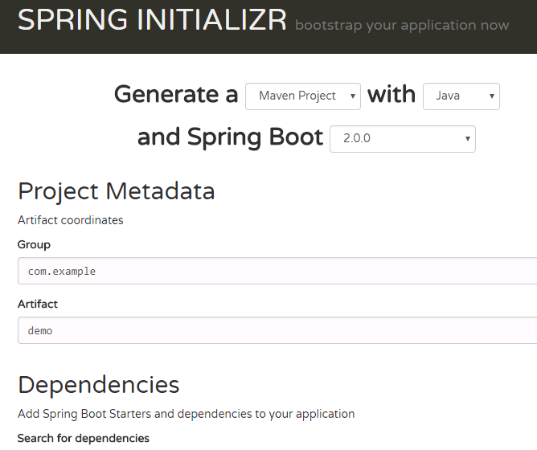
Spring Boot “Initializr”
Doesn’t require an IDE:
https://start.spring.io

Slide 5
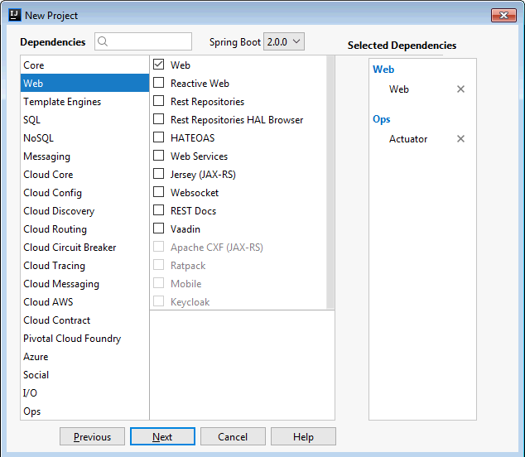
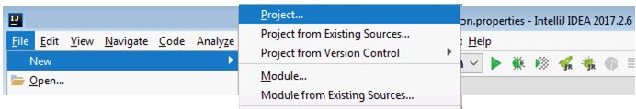
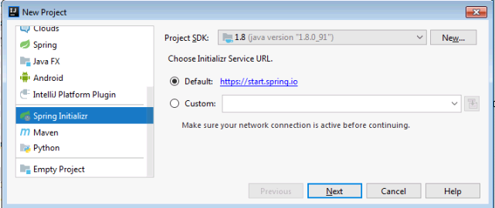
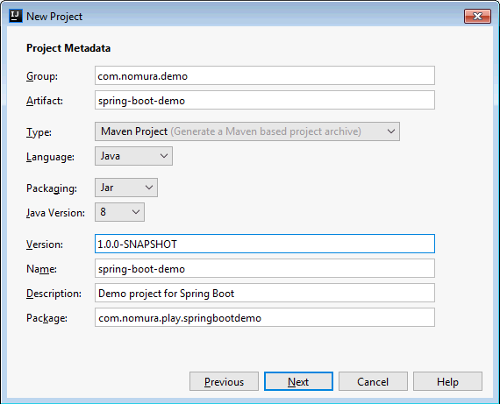
Initializr – Using IntelliJ

Slide 6
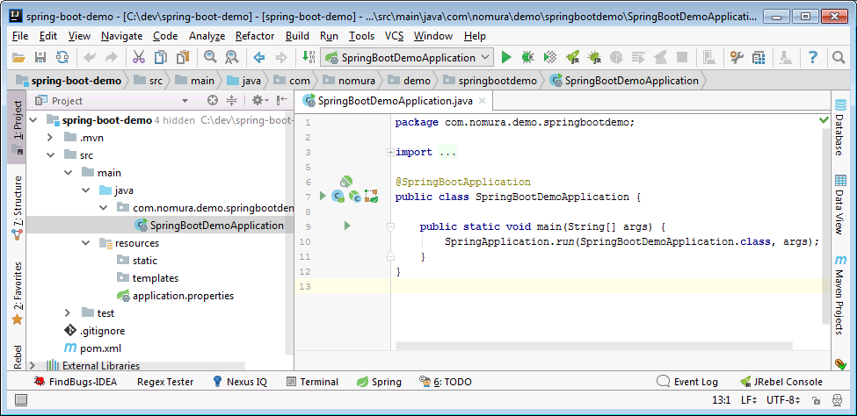
Spring Boot Initializr Generated Project
@SpringBootApplication:
@Configuration – Designates this as a config class
@EnableAutoConfiguration – Configures using sensible defaults
@ComponentScan – Scans classpath for Spring classes

Slide 7
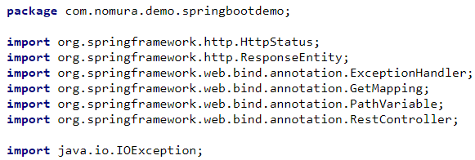
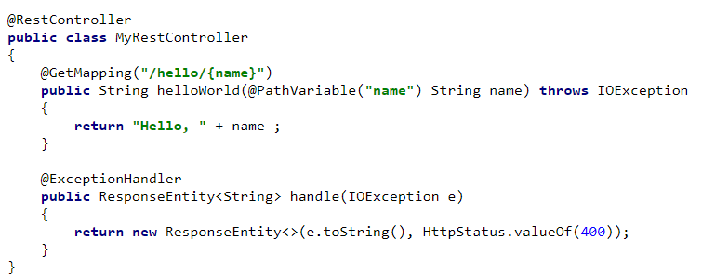


Slide 8
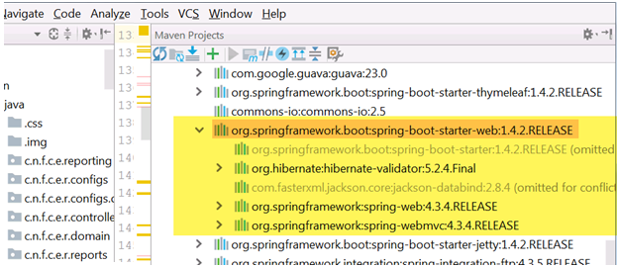
Starters
Starter: Curated bills of materials of dependencies and versions, guaranteed to be compatible.
All versions are inherited from the parent POM, just specify artifact.
List of starters https://github.com/spring-projects/spring-boot/tree/master/spring-boot-project/spring-boot-starters

Slide 9
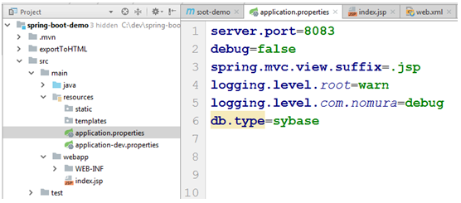
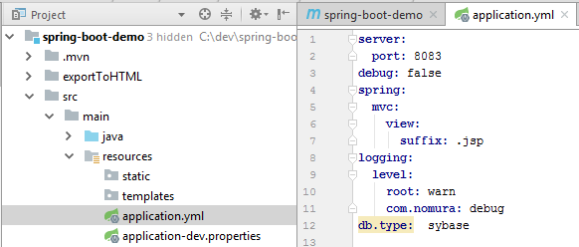
application.properties/ application.yml

Slide 10
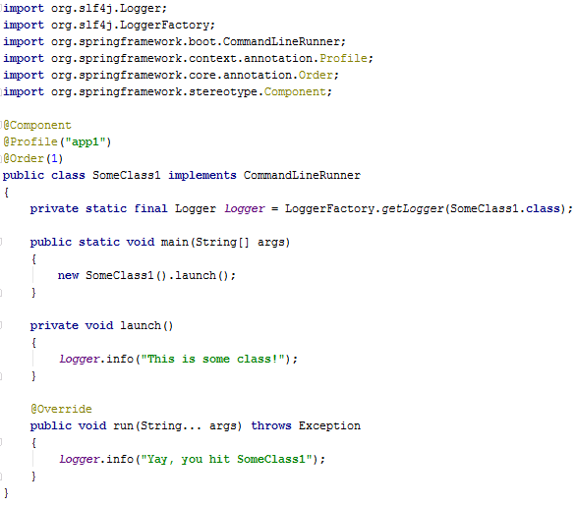
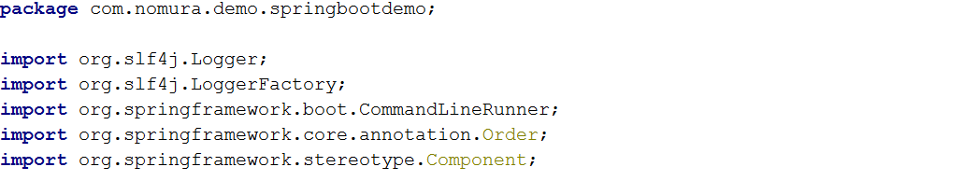
Notes:
package com.nomura.demo.springbootdemo;
import org.slf4j.Logger;
import org.slf4j.LoggerFactory;
import org.springframework.boot.CommandLineRunner;
import org.springframework.core.annotation.Order;
import org.springframework.stereotype.Component;
@Component
@Order(1)
public class SomeMainClass implements CommandLineRunner
{
private static final Logger logger = LoggerFactory.getLogger(SomeMainClass.class);
public static void main(String[] args)
{
new SomeMainClass().launch();
}
private void launch()
{
logger.info("Yay! You got it!");
}
@Override
public void run(String... args) throws Exception
{
launch();
}
}

Slide 11
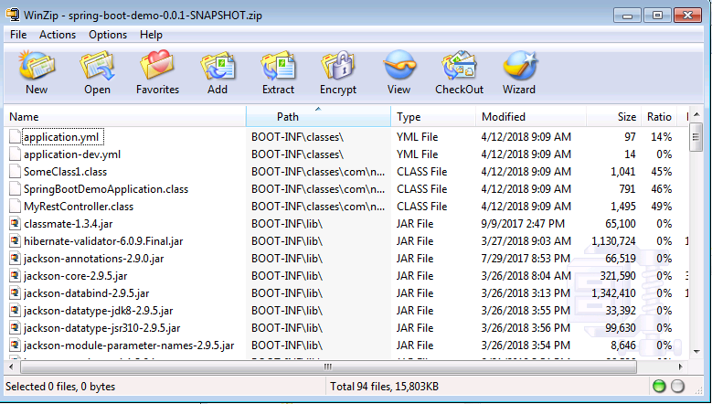
Build and run
Build the project as a jar or war, as with any Maven or Gradle build
mvn install
Jar contains all dependencies
To execute:
java –jar spring-boot-demo-0.0.1-SNAPSHOT.jar
mvn spring-boot:run
java –cpxxx com.nomura.demo.springbootdemo.SpringBootDemoApplication

Slide 12
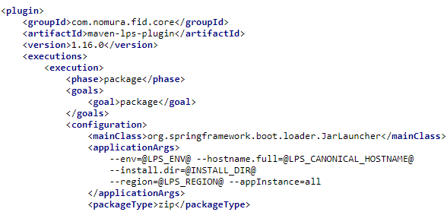
EOS/LPS Integration
Requires mvn lps plugin
Specify environment specific details using LPS env placeholders

Slide 13
Propstore Integration
Add a maven dependency:
<dependency>
<groupId>com.nomura.fid.core</groupId>
<artifactId>propstore-spring-boot-client</artifactId>
<version>2.0.4</version>
</dependency>
Add a query property in application.properties:
env property
propstore.property.sources=\
propertySourceName=MyProperties,env=dev || \
system=demo,app=my-app,region=eu
property source
Propstore query

Slide 14

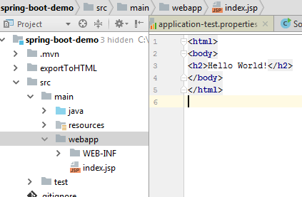
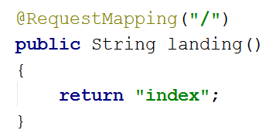
Converting a Web App
Move the webapp dir into main directory (No longer need WEB-INF)
Add @Controller annotation to the controller class
Map a suffix property: spring.mvc.view.suffix=.jsp
Create your RequestMappings:
Notes:
@RequestMapping("/")
public String landing()
{
return "index";
}

Slide 15
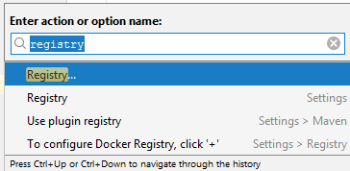
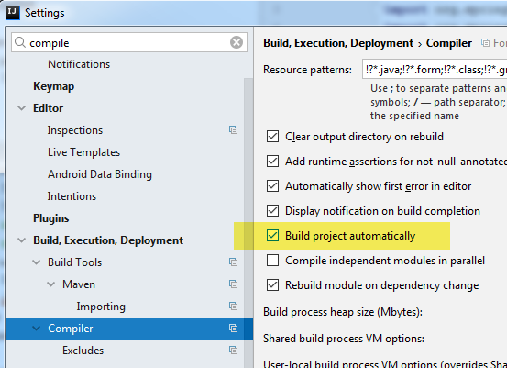
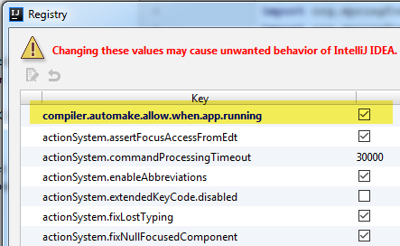
IntelliJ Settings for Spring Boot Dev Tools
Registry – Ctrl-Shift-A (then enter “registry”)
Notes:
@RequestMapping("/")
public String landing()
{
return "index";
}

Slide 16
logging
CommandLineRunner
Execution:
java –jar SpringBootDemo.jar
java SpringBootDemoApplication
Ordering @Order(1)
Profiles
Nested profiles
Testing
Propstore
EOS integration

